Slide 1
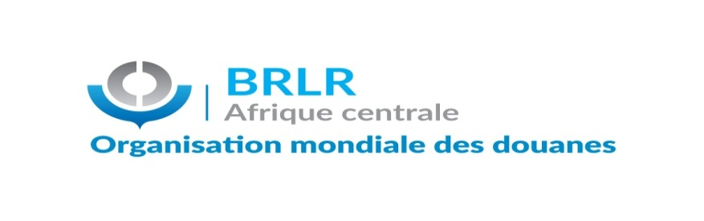


29TH CONFERENCE OF THE DIRECTORS-GENERAL OF CUSTOMS
BANJUL-GAMBIA, 04 TO 05 MAY 2023
Under the theme: “Nurturing the Next Generation by Promoting a Culture of Knowledge Sharing and Professional Pride in Customs”.
RILO-CA ACTIVITY REPORT
Presented by Mr NJOYA NJIMOLUH Ibrahim
DIRECTOR OF LRRO-NHQ
1

Slide 2
SYNOPSIS
INTRODUCTION
PART I: ADMINISTRATIVE MANAGEMENT
PART II: COMPARATIVE ANALYSIS OF
THE 2021 DATA ON 10 APRIL 2023 AND THE RESULTS
PART III: OUTLOOK

Slide 3
INTRODUCTION
The exchange of information and intelligence is the cornerstone of RILO activities.
2022 to April 10, 2023 was marked by several exchanges between administrations, RILOs and its partners.
Our report consists of three parts: the administrative management followed by the comparative analysis of the CEN data from 2020 to 2022 and the results, and finally the outlook.
3

Slide 4
1-MANAGEMENT
CURRENT OFFICIAL: M. NJOYA NJIMOLUH Ibrahim
TECHNICAL ATTACHÉS:
ESAMBA BOKEL'IPOKA Jean Paul, Technical Attaché of the Democratic Republic of the Congo to the RILO -CA.

Slide 5
2-RILO-CA PARTICIPATION IN MEETINGS, TRAINING AND SEMINARS
WCO statutory meetings: 21
Virtual (15) and face-to-face (6).
Statutory meetings of the subregion: 06
Virtual (2) and face-to-face (4)
Tasks of the Council for the Vice-President: 03
Virtual face-to-face (2) (1)
Seminars/ webinars: 23
WCOs: 11; virtual: 9 face-to-face:3
Meetings and seminars with partners (NGOs TRAFFIC and INTERPOL: 8
Virtual (3), face-to-face (5)
Service coordination meeting: 4
Notes:
Le BRLR-AC a participé à 32 rencontres.
5

Slide 6
3- EXCHANGE OF INFORMATION AND INFORMATION
A. ALERTS RECEIVED (ANALYSIS)
In collaboration with the other RILOs, RILO-CA received from June 2022 to April 10, 2023, 73
alerts repeated as follows:
BRLR/RILO | Drug | Fauna and flora | Hazardous material | Currency | Tobacco | Weapon and explosive | Other prohibition | Drug and pharmaceutical product | TOTAL
Western Europe/RILO-WE | 18 | 6 | 1 |  |  |  |  |  | 25
Eastern and Central Europe/RILO-ECE | 5 | 2 | 1 | 2 | 3 | 2 | 1 | 2 | 19
Asia Pacific/RILO-AP | 8 | 1 |  |  | 1 | 1 | 1 |  | 15
Joint Caribbean Intelligence Office/JIO | 7 |  |  |  |  |  |  |  | 7
Commonwealth of Independent States/ CIS | 4 |  |  |  | 1 |  | 1 |  | 7
TOTAL | 42 | 9 | 2 | 3 | 6 | 3 | 6 | 2 | 73
6
Notes:
8 domaines d’infraction ont été recensés durant cette période.
6

Slide 7
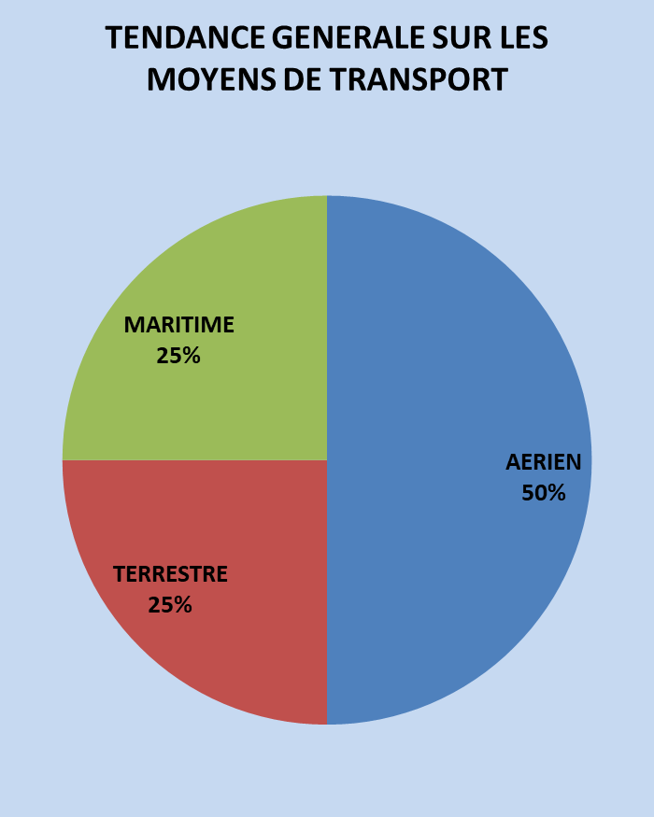
4 – B. ALERTS RECEIVED (ANALYSIS)
RILO | AIR | SEA | LAND | TOTAL
RILO-Western Europe | 17 | 5 | 3 | 25
RILO-Asia Pacific | 7 | 5 | 3 | 15
RILO-Eastern and Central Europe | 6 | 5 | 8 | 19
Commonwealth of Independent States | 2 | 1 | 3 | 7
Joint Caribbean Saint Lucia Intelligence Office | 4 | 2 |  | 7
TOTAL | 37 | 18 | 18
GENERAL TRENDS ON THE MEANS OF TRANSPORT
AIR
SEA
LAND
7

Slide 8
4 – C. EMISES ALERTS
NATURE OF PRODUCTS | INFRINGEMENT AREA | CONCEALMENT MEANS/OPERATING MODE/DESCRIPTION | MEANS OF TRANSPORT
Sardine with vegetable oil «BELLE VILLE» | Prohibition | In a container | Terrestrial
Fake quinine, drop 20% | Drug and pharmaceutical product | Case marked PROMED. | Terrestrial
Ivory tips and pangolin scales | Fauna and flora | container whose declaration indicated cashews as contents. In reality, these were specimens of endangered species including 456 kg of ivory and 6.2 tonnes of pangolin scales. | Maritime
Lower Quality Pediatric Drugs (MDG/WHO) | Drug and pharmaceutical product | In bottles | Terrestrial
Crocodiles | Fauna and flora | In a vehicle | Terrestrial
Dry chameleons and amphibian Goliath frogs (live) | Fauna and flora | In the ship | Maritime
8

Slide 9
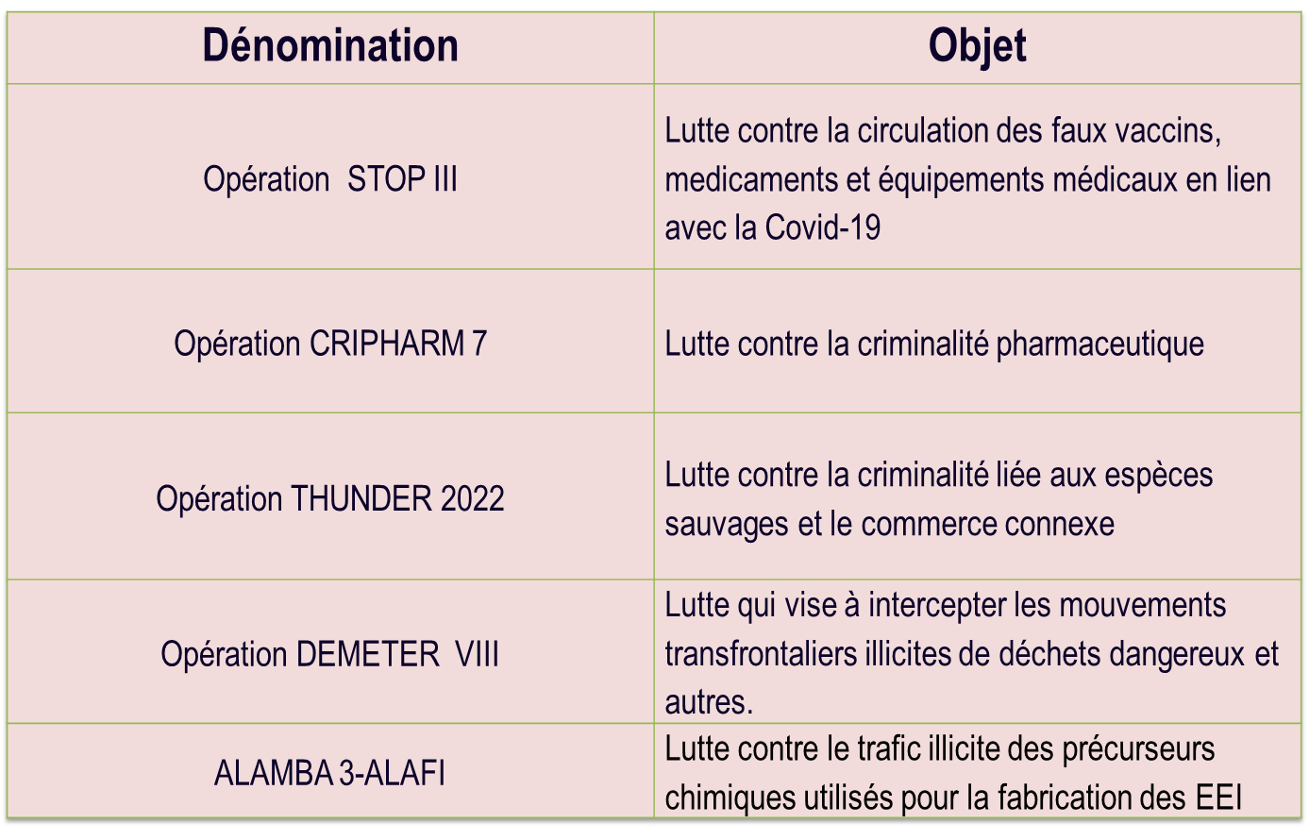
5-PARTICIPATION IN FRAUD PREVENTION OPERATIONS

Slide 10
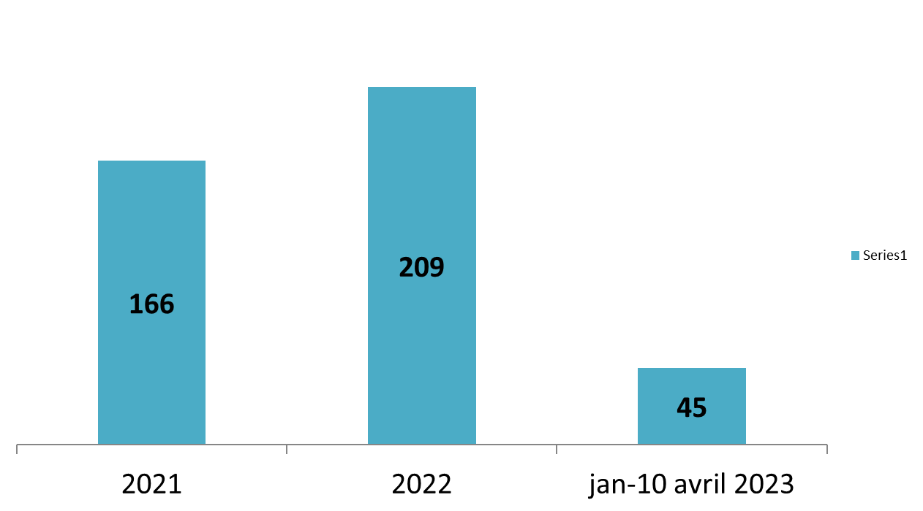
PART II: ANALYSIS OF CEN 2021 AS OF 10 APRIL 2023 AND RESULTS
OVERALL DATA SITUATION: 420 CASES
By year: 166 in 2021, 209 in 2022 and 157 from June 2022 to April 10, 2023.
10

Slide 11
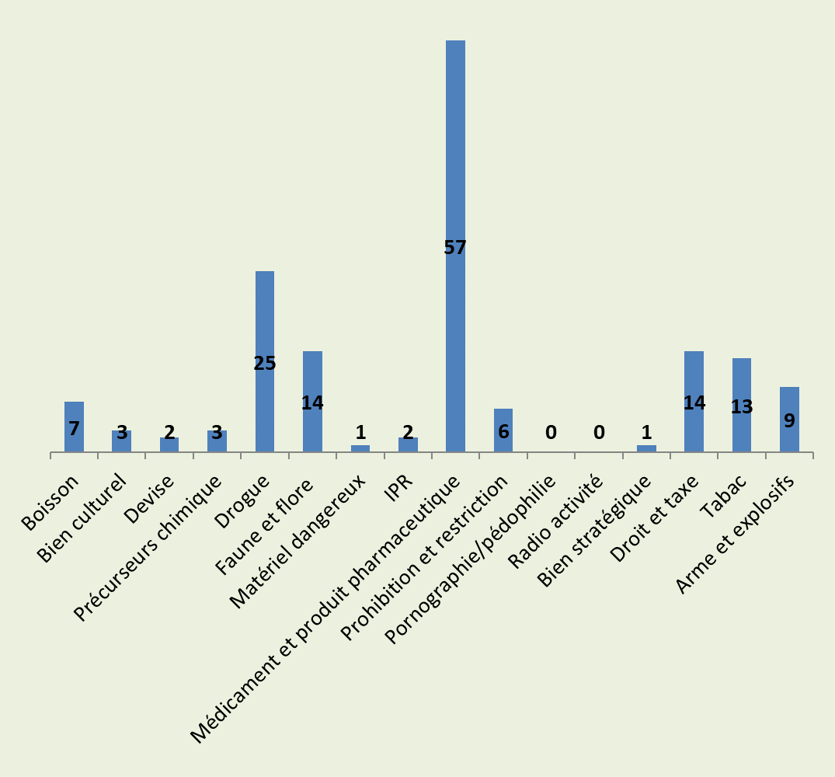
PART II: ANALYSIS OF DATA FROM JUNE 2022 TO 10 APRIL 2023 AND RESULTS
INFRINGEMENT AREA | TOTAL
Drink | 7
Cultural property | 3
Currency | 2
Chemical precursors | 3
Drug | 25
Fauna and flora | 14
Hazardous material | 1
IPR | 2
Drug and pharmaceutical product | 57
Prohibition and restriction | 6
Pornography/Pedophilia | 0
Radio activity | 0
Well strategic | 1
Duty and tax | 14
Tobacco | 13
Weapon and explosives | 9
TOTAL | 157
11

Slide 12
PART II: ANALYSIS OF DATA FROM JUNE 2022 TO 10 APRIL 2023 AND RESULTS
OVERALL SITUATION OF DATA BY COUNTRY:
INFRINGEMENT AREA | CAMEROON | RCA | GABON | DRC | CHAD | CONGO | TOTAL
Drink | 3 | 1 | 1 | 1 | 1 | 0 | 7
Cultural property | 0 | 0 | 3 | 0 | 0 | 0 | 3
Currency | 0 | 0 | 0 | 0 | 2 | 0 | 2
Chemical precursors | 0 | 0 | 1 | 2 | 0 | 0 | 3
Drug | 16 | 1 | 1 | 3 | 2 | 2 | 25
Fauna and flora | 7 | 3 | 0 | 4 | 0 | 0 | 14
Hazardous material | 1 | 0 | 0 | 0 | 0 | 0 | 1
IPR | 0 | 0 | 2 | 0 | 0 | 0 | 2
Drug and pharmaceutical product | 20 | 20 | 14 | 1 | 0 | 2 | 57
Prohibition and restriction | 1 | 1 | 2 | 1 | 1 | 0 | 6
Pornography/Pedophilia | 0 | 0 | 0 | 0 | 0 | 0 | 0
Radio activity | 0 | 0 | 0 | 0 | 0 | 0 | 0
Well strategic | 0 | 0 | 1 | 0 | 0 | 0 | 1
Duty and tax | 11 | 0 | 0 | 3 | 0 | 0 | 14
Tobacco | 8 | 0 | 2 | 1 | 2 | 0 | 13
Weapon and explosives | 6 | 3 | 0 | 0 | 0 | 0 | 9
TOTAL | 73 | 29 | 27 | 16 | 8 | 4 | 157
12

Slide 13
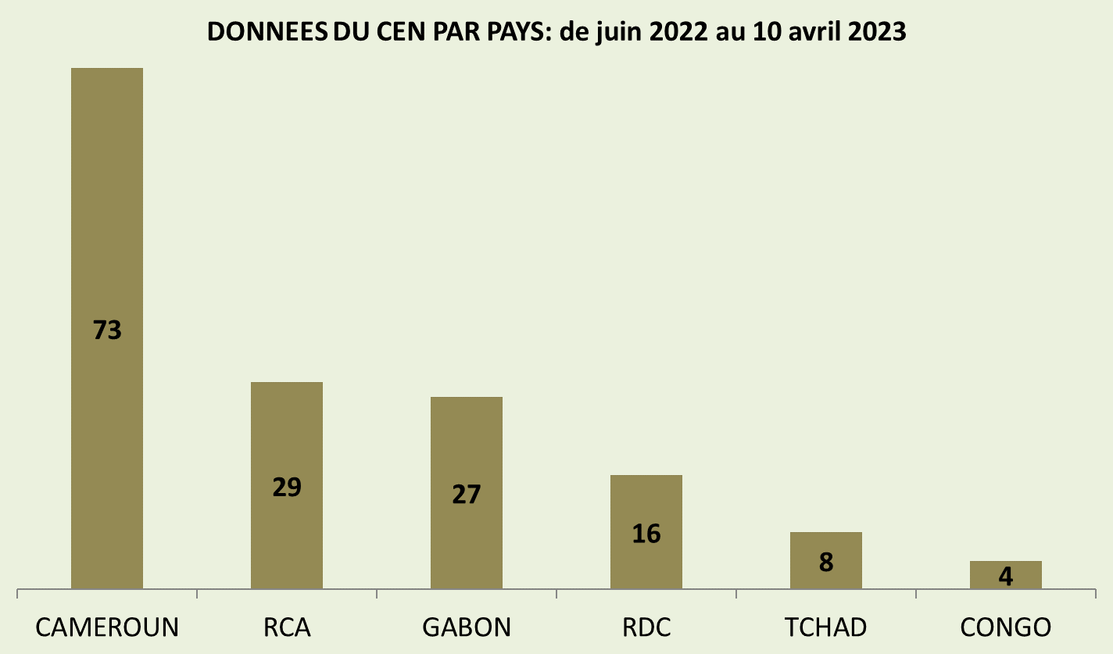
PART II: ANALYSIS OF DATA FROM JUNE 2022 TO 10 APRIL 2023 AND RESULTS
13

Slide 14
PART II: ANALYSIS OF DATA FROM JUNE 2022 TO 10 APRIL 2023 AND RESULTS
Drugs are selected for analysis
Cameroon: 20, DRC:1, Congo:2, Gabon 14, CAR: 20, Chad:0 Total: 57
Quantity: 36 kg, 25 pieces, 1 liter and 5 others.
The drugs most seized are the anti infectious metabolic agents, dietary supplements and agents of the nervous system.
Concealment: The main means of concealment is in transport with 31 cases, in baggage 15 cases and in cargo 11 cases;
Detection: intelligence 34 cases, routine 19 cases, follow-up of routine 19 cases;
Means of transport: vehicle 26 cases and aircraft 31;
Country of departure: Nigeria 18 and DRC 7;
Country of destination: Cameroon in the lead followed by CAR
14

Slide 15
INITIATIVES TAKEN
-Operation Senghor to combat illicit trafficking of cultural goods;
-Operation Bonobo; against the illicit trafficking of specimens of great apes, pangolins and elephants;
-Operation Bakwanga; on the illicit trafficking of rough diamonds;
-Continuing training on CEN and customs intelligence at regional level (as in the case of the CN of Congo Brazzaville).

Slide 16
DIFFICULTIES
-Mixed engagement of sub-region member countries in the exchange of information and intelligence;
- Insufficient funding sources for BONOBO, BAKWANGA and SENGHOR projects already adopted by the region);
- inadequate equipment for certain National Correspondents (NCs);
- Mixed commitment by some National Correspondents to the introduction of data into the CEN.

Slide 17
OBSERVATIONS
Drugs seized more than other products through CRIPHARM;
Cameroon, CAR and Gabon have done much more than the others.
17

Slide 18
PERSPECTIVES AND RECOMMENDATIONS
- Strengthen the process of further cooperation between the RILO-CA and other regional (CEMAC, CEEAC, etc.) and international intelligence structures (TRAFFIC, INTERPOL, etc.), fight against fraud;
-To enhance the protection of the biodiversity of the Central Africa sub-region through significant operations (wildlife and floristic species).
In the analysis part;
Continuity of the CRIPHARM operation;
Awareness of different jurisdictions to allow CN to introduce a lot of cases…

Slide 19

THANK YOU FOR YOUR ATTENTION

